Slide 1
Morse Code Translator
Kevin Zhang, Ethan Manfredi, Denalda Gashi

Slide 2
Goal/Motivation
Our goal was to create a morse code translator that would take in a sequence of button pushes corresponding to dots and dashes, translate that message, and display it to the monitor through VGA.
This could be used in real life with people working in maritime or aviation that rely on morse code when other forms of communication fail.

Slide 3
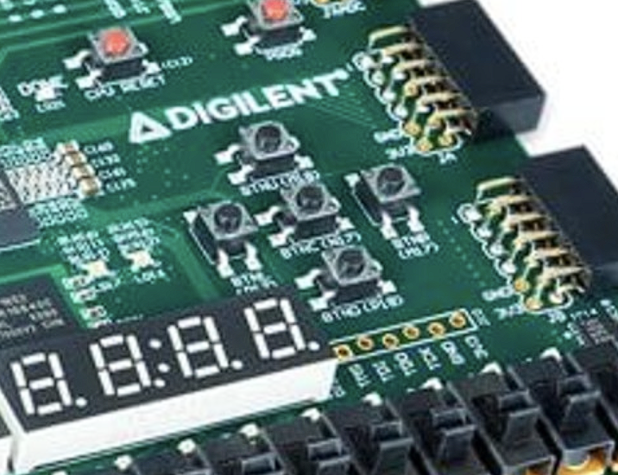
Functionality
When the user presses the Dot or Dash button for < 1 seconds, the FPGA sends a binary signal 01 corresponding to DOT.
If the button is pressed for > 3 seconds, then the FPGA sends a binary signal 10 corresponding to DASH.
When the user presses the SEND button, a binary signal 11 is sent and the ASCII character the user sent is displayed on the VGA.
When nothing is pressed, the binary signal is 00 where nothing will change.
3 buttons:
Dot or Dash
Send
Reset

Slide 4
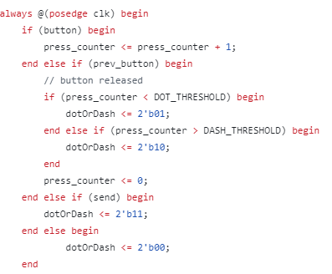
Timing Control Module
dotOrDash== 01 —> Dot
dotOrDash == 10 —> Dash
dotOrDash == 11 —> Send
dotOrDash == 00 —> Wait

Slide 5
Specification
To make a morse code translator, we needed to utilize the buttons, clock, and VGA display of the FPGA
An 8x16 grid of pixels was used to display each letter
The ascii_rom.v file was used to assign 16 8-bit numbers to represent which pixels in the grid need to be on to display the character
Displaying the letters is somewhat rudimentary since each letter is placed using specific x and y coordinates

Slide 6
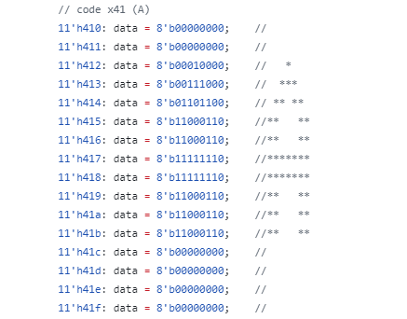
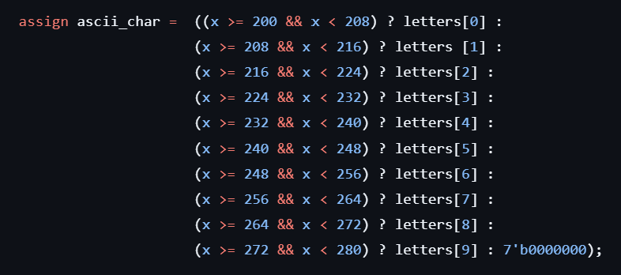
How does the Morse Code Translator display each letter?
To display multiple characters, ascii_char selects the letter from the letters array based on the x coordinate and maps it to specific horizontal pixel ranges on the screen. Each 8-pixel-wide segment corresponds to one character, forming a horizontal line of text. For pixels outside the defined range, ascii_char defaults to displaying nothing.

Slide 7
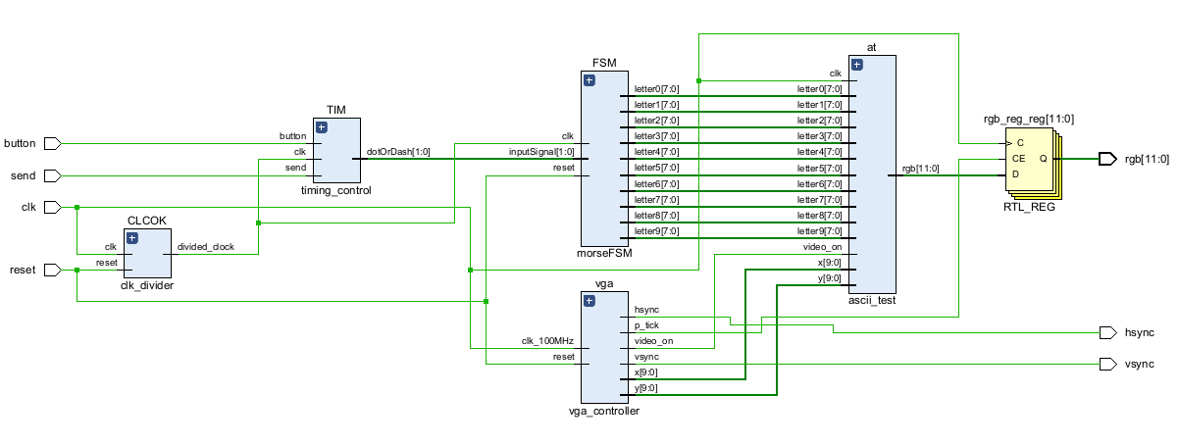
Block Diagram Decoding the Button Sequences

Slide 8
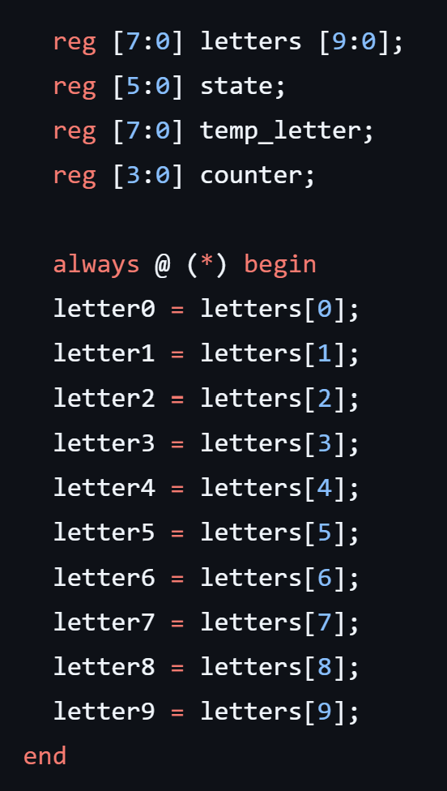
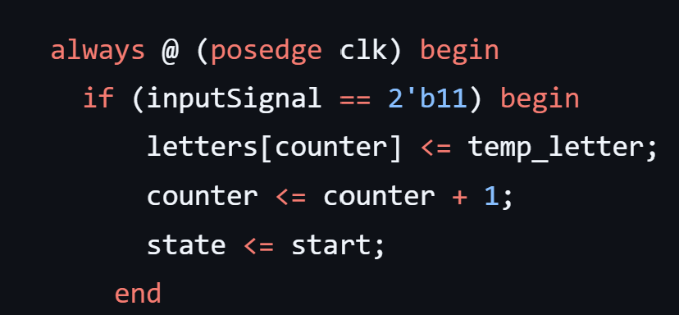
How does our Morse Code Translator store a letter?
Create a 10 element array that will hold each letter sent by the FPGA.
When the SEND button is pressed, temp_letter is stored in the letters array, the counter will increment by one, and then the
state is sent back to start where temp_letter is cleared.

Slide 9
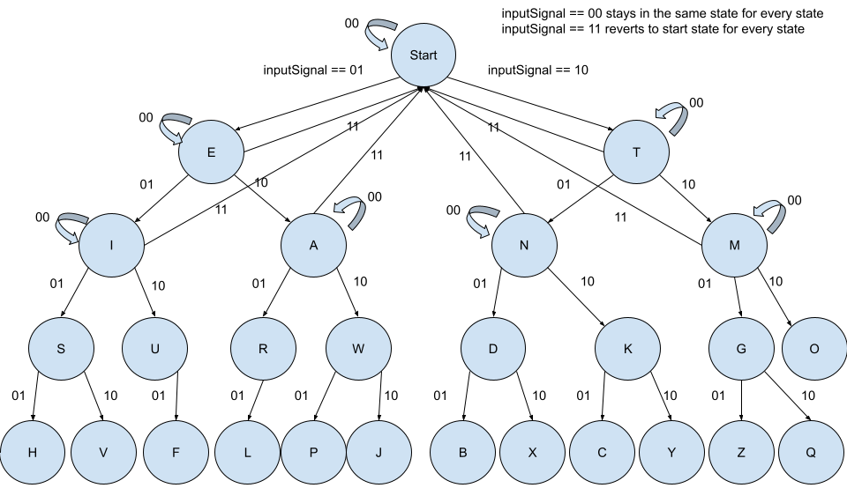
State Diagram
inputSignal == 01 —> Dot
inputSignal == 10 —> Dash

Slide 10
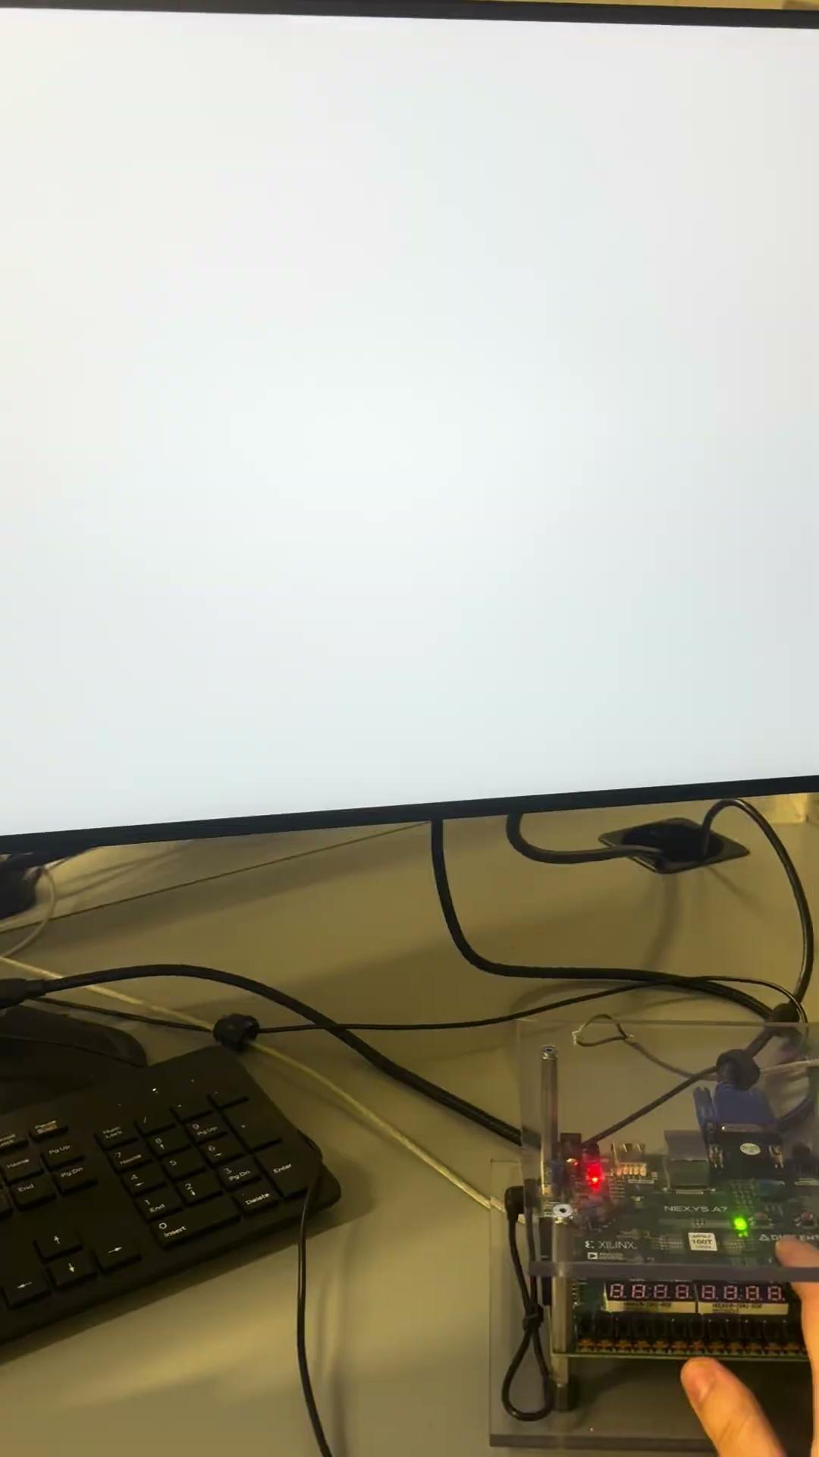

Slide 11
Successes!
Our Morse Code Translator is able to accurately decode the sequence sent by the FPGA to the correct ASCII character!
The system can accurately distinguish between a dot and a dash based on the timing control implemented.
We were also able to display multiple ASCII characters on the screen and have the previous characters still displayed on the screen!

Slide 12
Failures
Currently, our reset button does not clear the screen so we are working on debugging that button.
The Morse Code translator is also only able to hold 10 ASCII characters. We could look into how we could hold more values or have a dynamic array that isn’t previously defined
To display multiple characters on the screen, we had numerous bugs that had to be fixed and we solved these issues using test benches to determine if the bugs were from the state machine, timing control, etc.
We also had to do numerous tests in order to get the timing control right and figure out the parameter to slow the clock down.

